Slide 1
Dynamic Normalization Network
How can we achieve global image normalization through local (pixel-wise) interactions?
Could this mechanism account for some brightness/lightness illusions?
Outline of presentation
Diffusion equations?
Questions/Summary Take Home at each slide
Listen to what I say or read what I wrote?
Ask what level of detail wanted NOW?
Too much text version vs show version simple

Slide 2
Outline
Differential equations (the Diffusion equation)
Diffusion layers (Darkness & Lightness layers)
Normalization (Linear scaling scheme)
Testing (Application to visual illusions)
Conclusions & Future Developments

Slide 3
Differential equations intro
The computation of a system’s evolution based purely on the initial conditions and the designed dynamics of the system.
In this case, the diffusion equation satisfies the dynamics which we desire, that is, a spatially-discrete processing mechanism in 2D.

Slide 4

Diffusion equation 1
Overview
The diffusion equation is steered to different dynamics by λ parameter
K operator applies a comparison operation to the nearest neighborhood of each pixel in the image.
Operator → mathematical tool which applies a certain method to a function

Slide 5
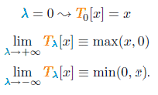
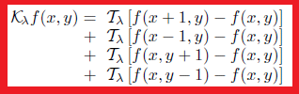
Diffusion equation 2 λ steers dynamics in T
λ in turn dictates how the T operator functions
T operator states either no operation to input x, max(x,0) or min (x,0)
T operator is applied to the local surround as described in K operator

Slide 6
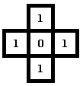
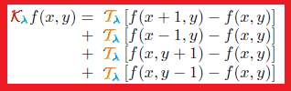
Diffusion equation 3
K operator walk-through
In K, T is applied to the difference between the surround neighborhood and central pixel,
If we choose λ=-inf, then T(λ) becomes min(x,0), “is the difference smaller than 0?”, if yes return x, if not return 0. We then find K*f(0,0) = 4 x min(1,0) = 0
Therefore local minimum is preserved.
If we choose λ=+inf, then T(λ) becomes max(x,0) and K*f(0,0) = 4.
Therefore local minimum value has been “eaten” or overwritten by the local surround.
In this way a local operation results in a global average. The “±inf λ” parameter states are described as the lightness diffusion layer and darkness diffusion layer

Slide 7


Diffusion equation 4
Diffusion layers
Two diffusion states: “a” applies minimum operator (where, λ=-inf) upon local surround, “b” applies maximum operator (where, λ=+inf) upon local surround.
At time zero, the solution of the diffusion equation is simply the input stimuli, and as time evolves, the nearest neighborhood interactions develop the two diffusion layers a and b, “darkness and lightness diffusion layers”.

Slide 8
Diffusion equation 4
Solving differential equations
There are multiple methods to extract solutions (states) from these diffusion equations.
Euler method is simplest and easiest
4th Order Runga-Kutta method is more accurate/robust but more complicated and computationally expensive
So far, both method find qualitatively equivalent outputs.

Slide 9
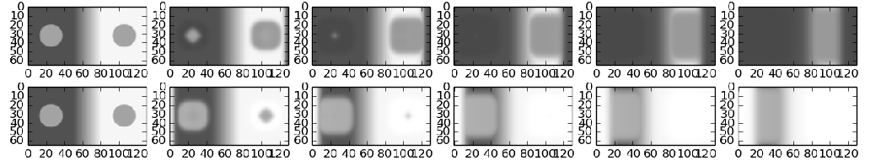
Diffusion layers
Visualising diffusion states
Below are some solutions to a (darkness) & b (brightness), the diffusion state equations.
a
b
“t” (states over time)
In a, the darkness diffusion layer, darker pixels “eat” lighter pixels, resulting in the growth of local darkness.
In b, the lightness diffusion layer, lighter pixels “eat” darker pixels, resulting in the growth of local lightness.
From finding the “zero state luminance” (darkest value) and “one state luminance” (lightest value), we can go onto normalise the initial image.

Slide 10
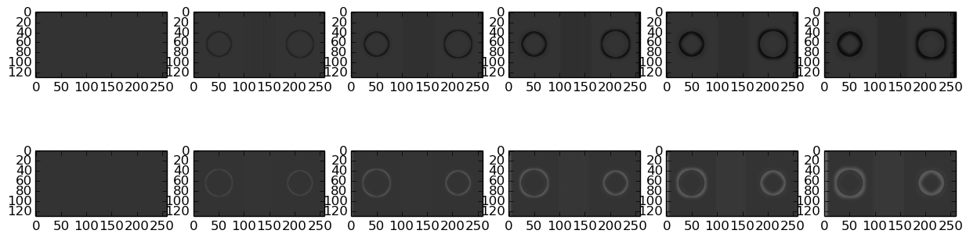
Diffusion Layers
Change in diffusion states over time
To provide some more insight into this process we can visualise the change in solutions as compared to the initial time step.
In the darkness layer (a) the surround of the right patch darkens whilst the inner of the left patch darkens,
In the lightness (b) diffusion layer, lightening within the right patch, lightening of outer edge of left patch.
a
b
“t” (change in states over time)

Slide 11
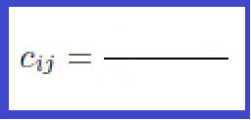

Normalization
Recombining the two diffusion layers
The solutions to the two diffusion equations (darkness diffusion layer & brightness diffusion layer) are then recombined with the initial image to generate a normalized image , using the below equation.
stimuli scaled to zero
(input - min)
luminance range
(max - min)
This is equivalent to a linear scaling scheme used for scaling a fixed set of numbers.

Slide 12


Normalization
Dynamic vs Steady-state solutions
Steady-state solution to full dynamic equation
The benefit of having a full dynamic equation means we can avoid the singularity at b=a.
Steady state is fast and simple solution.
So the two equations are applicable under different circumstances, but ultimately model the same process, namely normalisation.

Slide 13
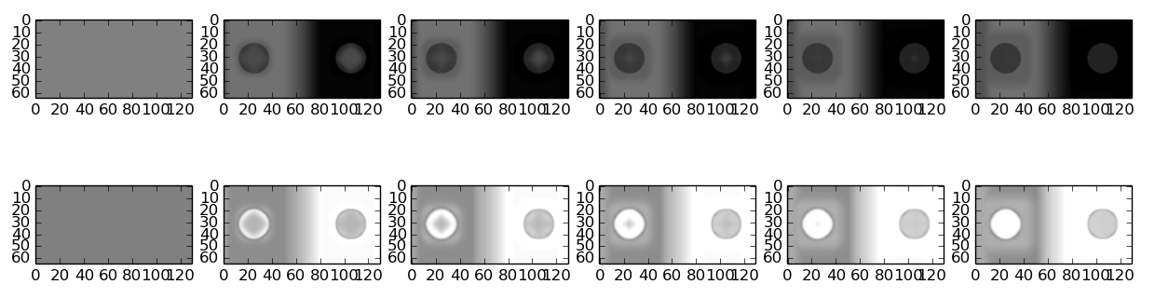
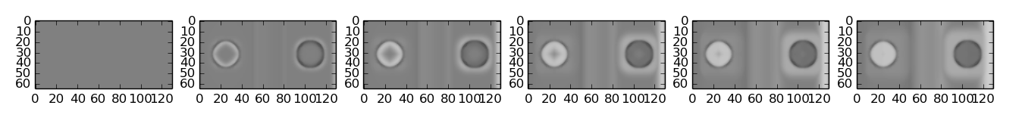
Normalization
Dynamic solution intermediate steps
Top “b(0-c)”, middle “-a(1-c)” and bottom “b(0-c)-a(1-c)”
Not intuitive. Nevertheless we can observe correct directional lightness changes in the patches (i.e. lightening left, darkening right in the bottom two figure).
t

Slide 14



Normalization
Change in normalized output over time
Input Image
Steady state solution
Dynamic solution

Slide 15
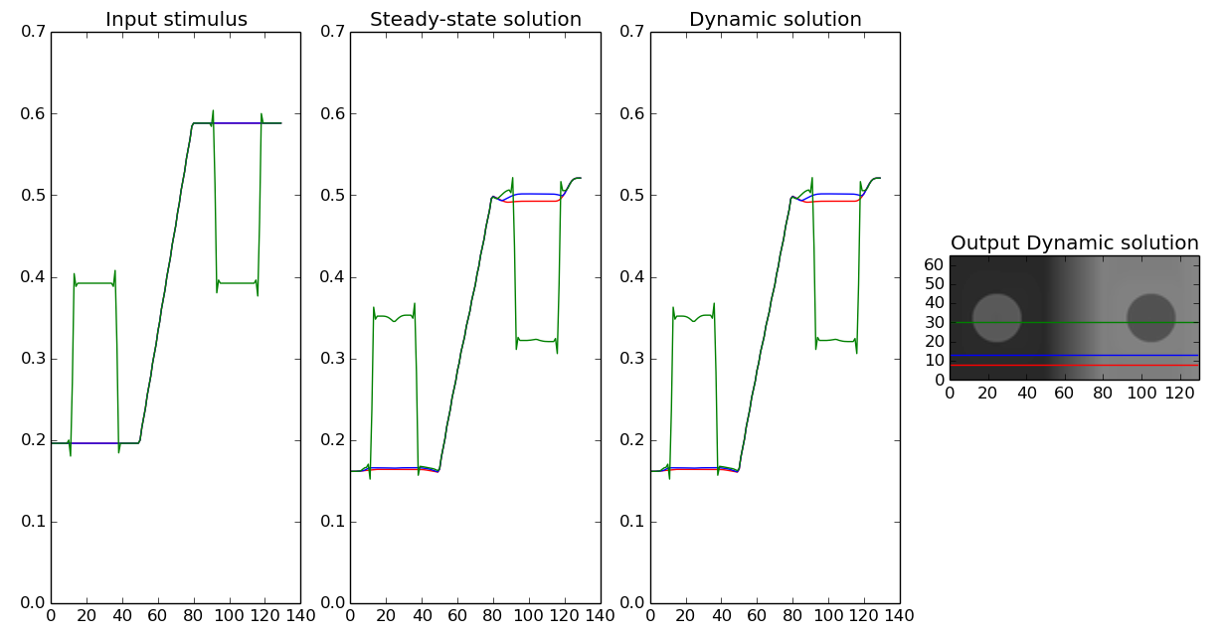
Testing
Profile of Outputs
We can observe physical luminance change between patches.

Slide 16
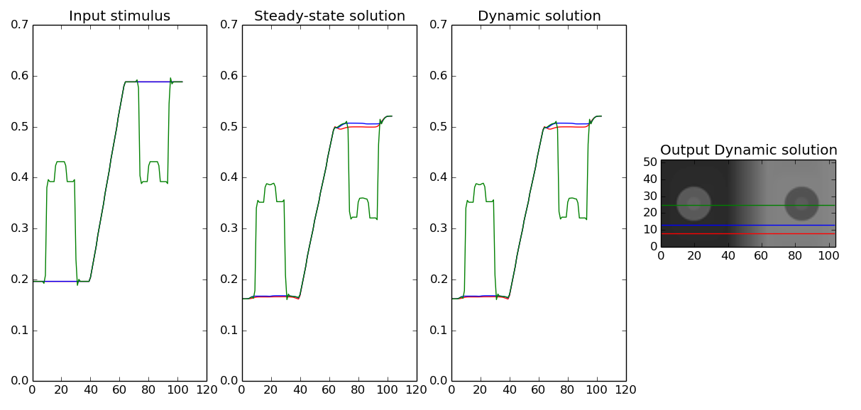
Testing
Internal patch
Also, occurs for internal patches

Slide 17
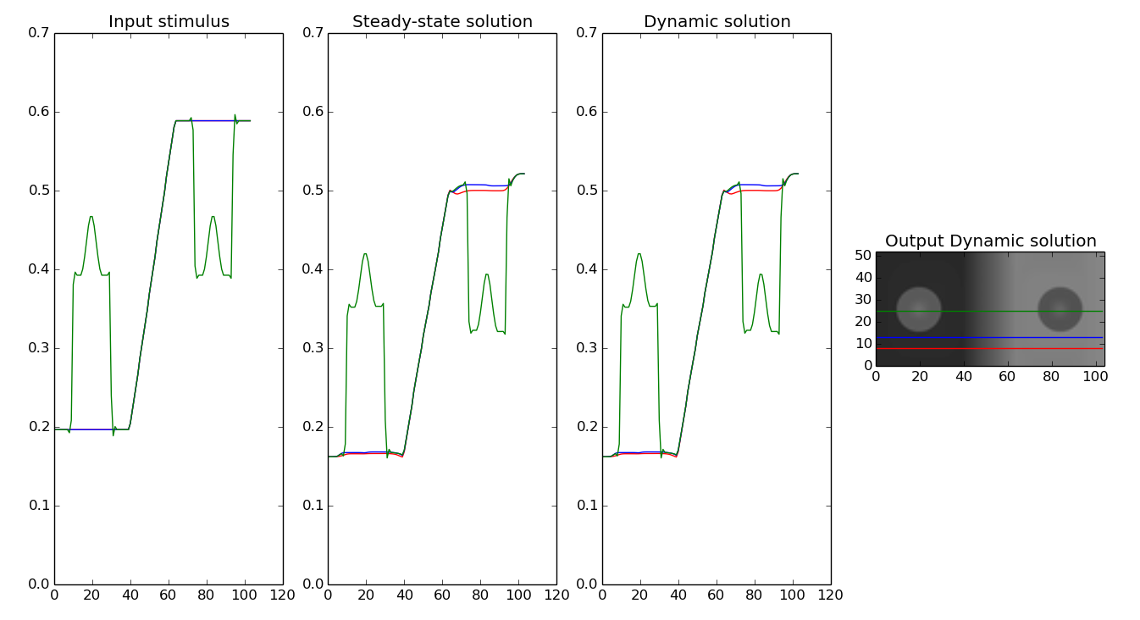
Testing
Internal patch blurred edges
Also occurs for blurred internal patches

Slide 18
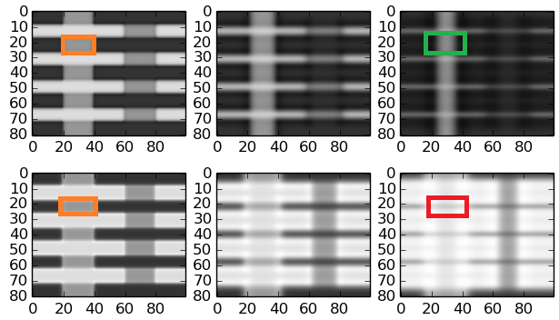
Testing
White's failure
Consider the steady state solution for one of the left hand test patches.
We observe brightening in brightness layer (b) and darkening in darkness layer (a)
e.g. on luminance scale 0<L<1: s=0.5, a = 0.3, b =0.7 => c = s-a/b-a=0.4, incorrectly predicts a darkening of the left patches.
The normalized luminance change goes in the wrong direction. This is due to the greater quantity of light local surround to the left patches.
a
b

Slide 19

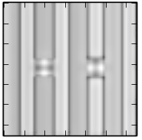
Testing
White's continued
Changing the context of the test patch surround to the stimuli below,
Equivalent darkening “fills-in” from the dark edges and lightening “fills-in” from the light edge
Resulting in no physical change in the luminance.
In short, as we saw for the previous stimuli, the quantity of dark/light edges dictates the change in luminance in the dynamic normalization network.
“Decrements →lightening / Increments → darkening”
Stimuli
Diffusion layer

Slide 20
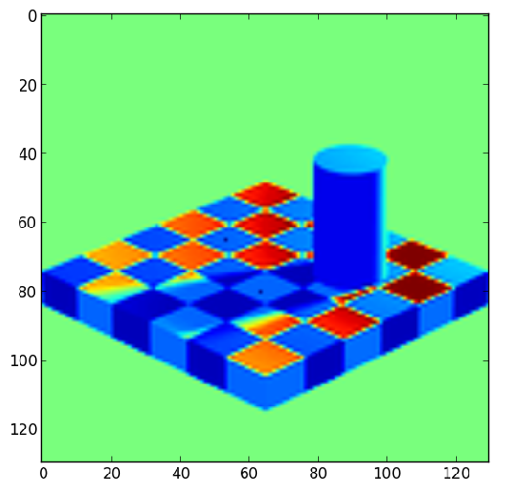
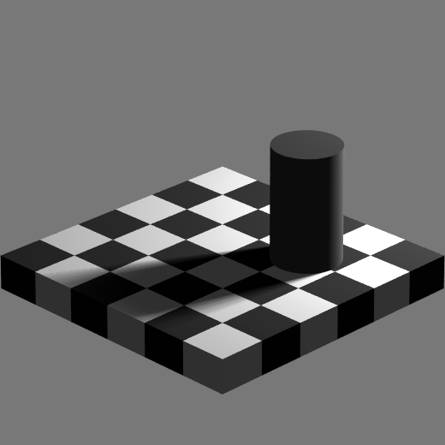
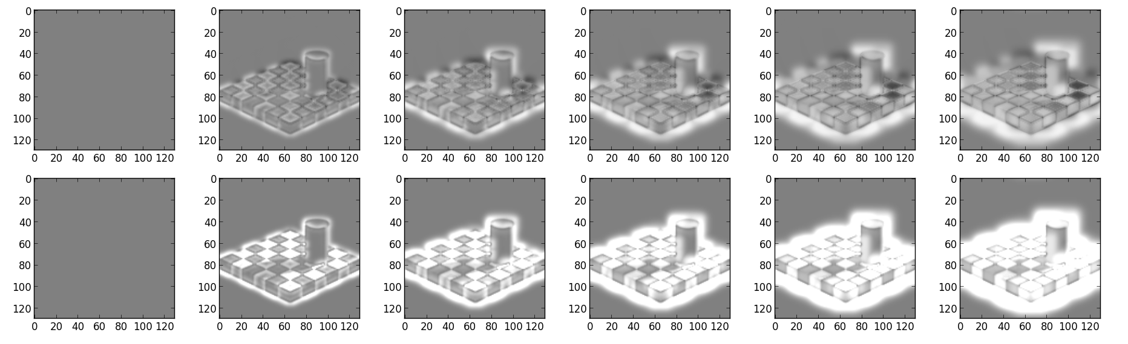
Adelson
No change in difference between test checks

Slide 21
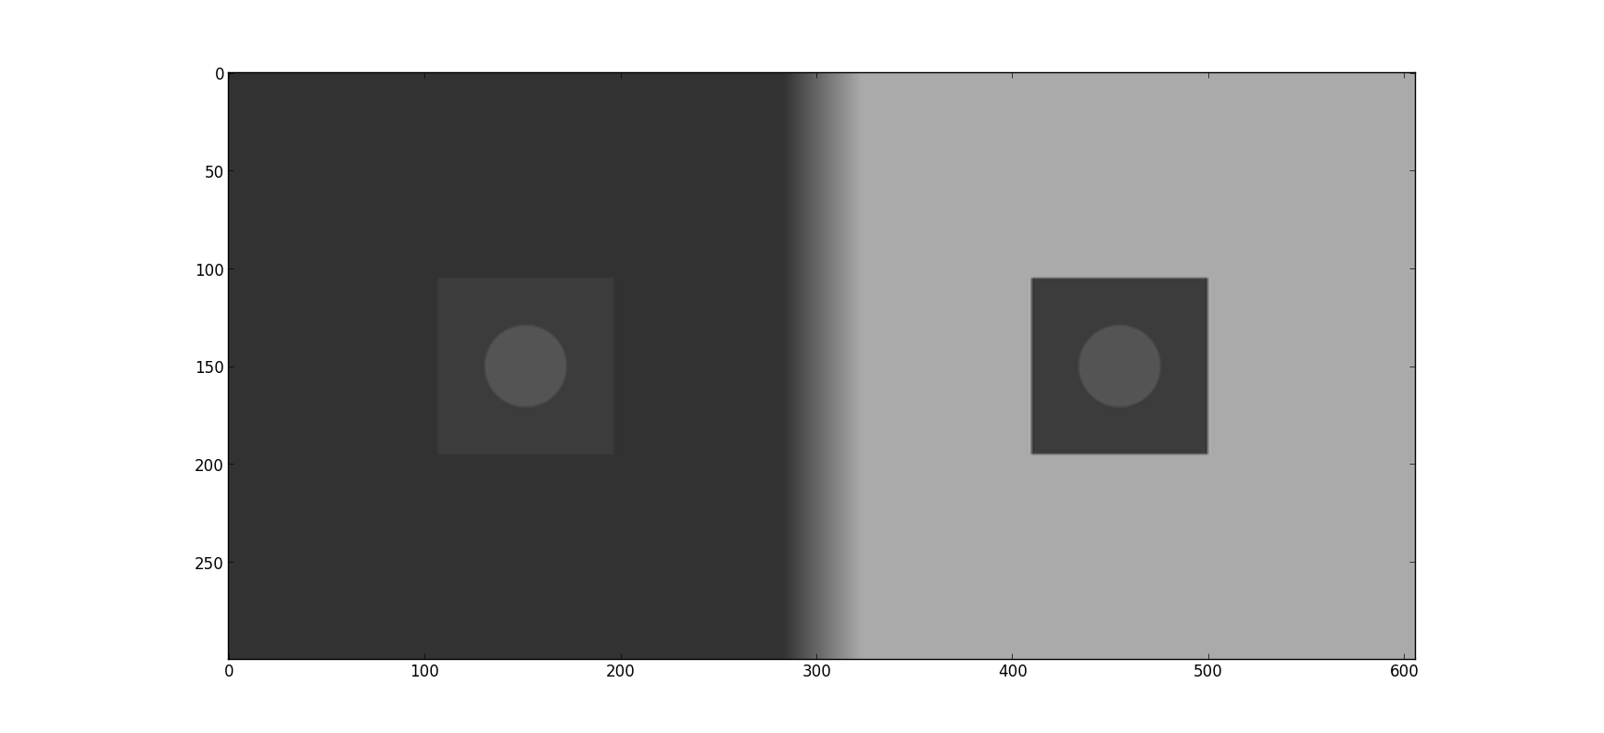
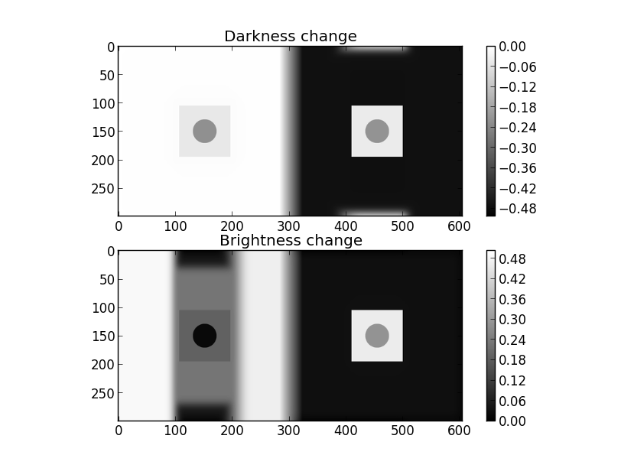
Modulating inner patch luminance (ignore slide)

Slide 22
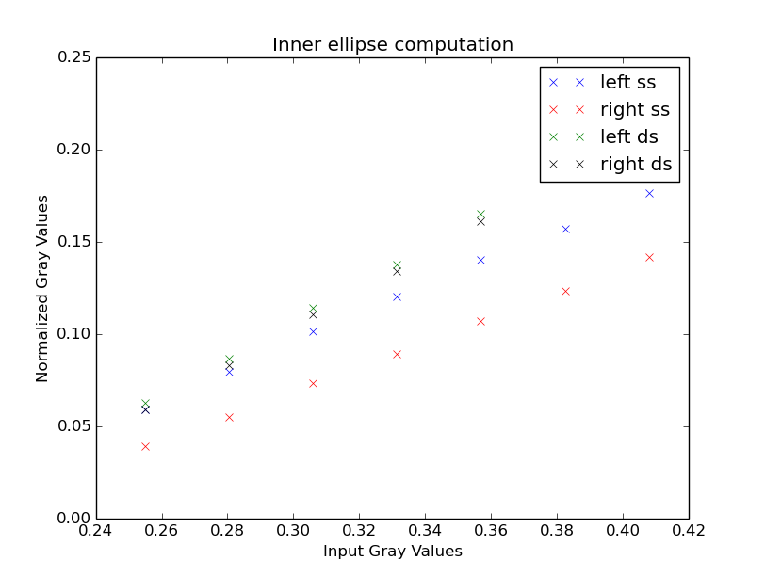
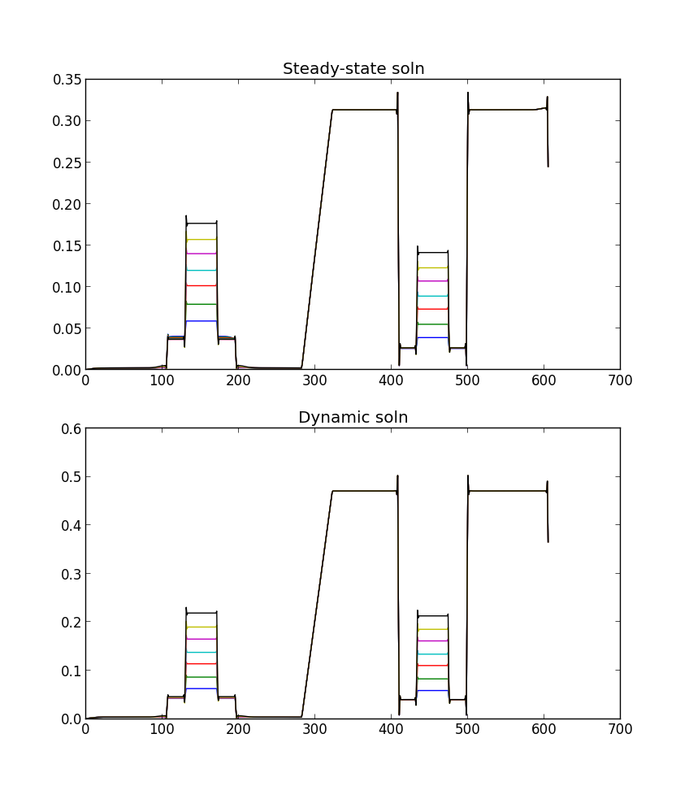
Testing
Modulating inner patch luminance
Plot gradients as output

Slide 23
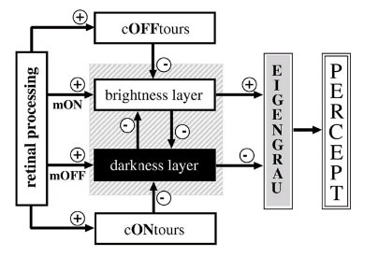
In context of full model
Viewed current output represent end point of normalization process or “brightness layer” diffusion filling-in, also ON-type contrast

Slide 24
Possible future work
Combined with edge detection & FIDO code from Francis model to average normalized change within edge domains.
Build on description of why White's fails and why SBC works.
Expand model with cONtours & cOFFtours

Slide 25
Conclusions
Questionable neurophysiological plausibility
Fails for Adelson's & White's
Luminance information “fills-in” from contrast edges (see real world videos)
Lightness effects observed in SBC with inner patches

